Slide 1

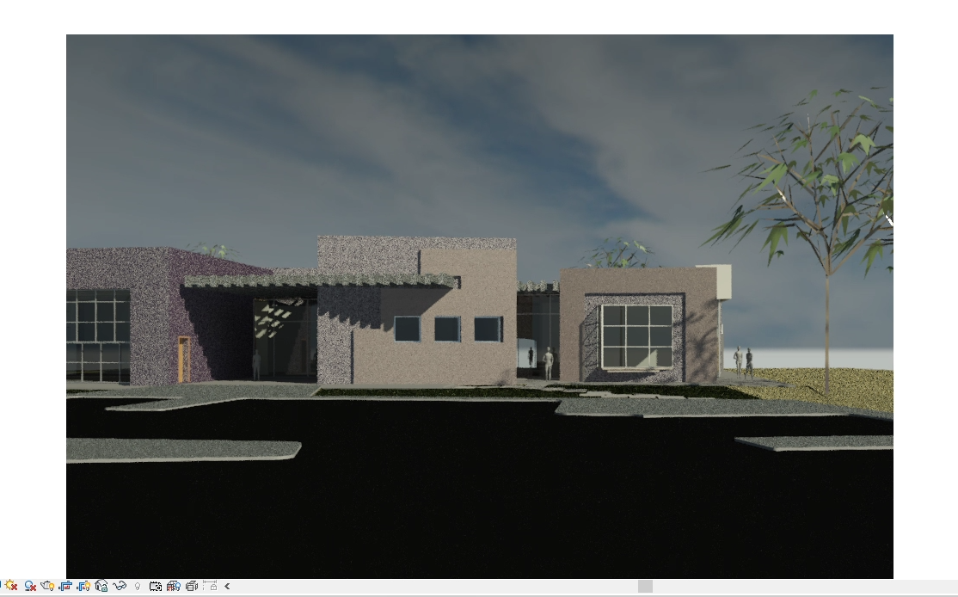
This is my image I rendered and my walkthrough.

